Slide 1
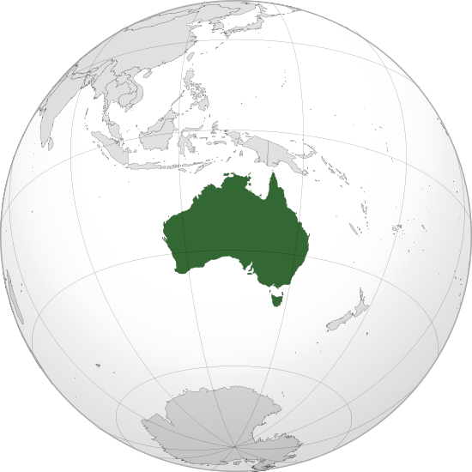
Australia
Commonwealth of Australia is a country comprising the mainland of the Australian continent, the island of Tasmania and numerous smaller islands

Slide 2
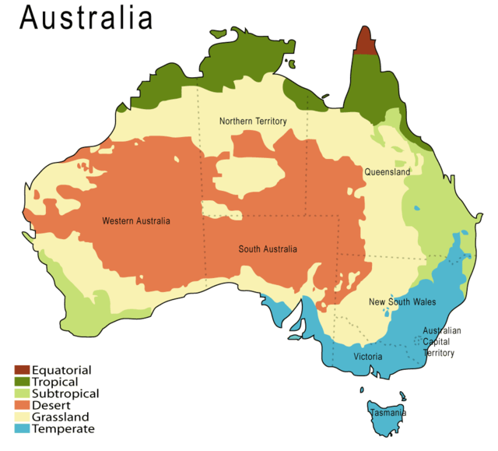
States and territories
Australia has six states- New South Wales(NSW), Queensland(QLD), South Australia(SA), Tasmania(TAS), Victoria(VIC) and Western Australia(WA)- and two major mainland territories- the Australian Capital Territory(ACT) and the Northern Territory(NT)

Slide 3
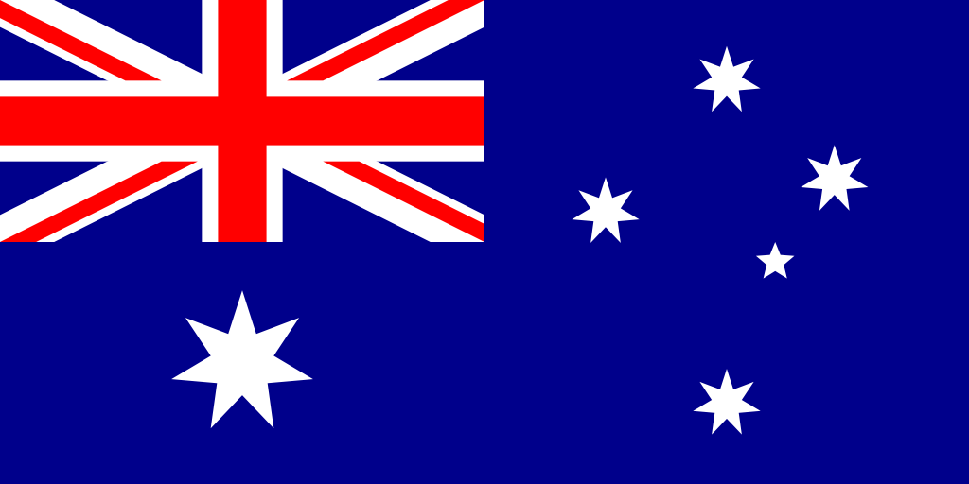
On 1 January1901, the six colonies federated, forming the Commonwealth of Australia.

Slide 4
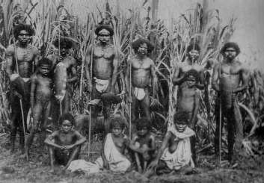
Indigenous Australians
For at least 40.000 years before the first British settlement in the late 18th century Australia was inhabited by indigenous Australians.

Slide 5
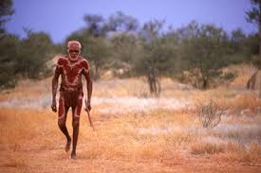
Aborigines
Aborigines were nomads. They moved from place to place looking for food.

Slide 6
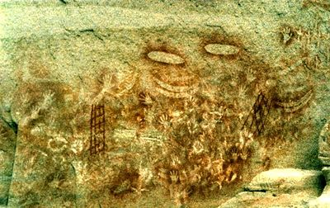
The Dreamtime
Aborigines believed that ,once in the past powerful spirits created the land and the people. This time of creation is called the Dreamtime.

Slide 7
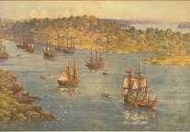
The arrival of white settlers
When white settlers arrived, they took away the land from the Aborigines and destroyed their way of life.

Slide 8
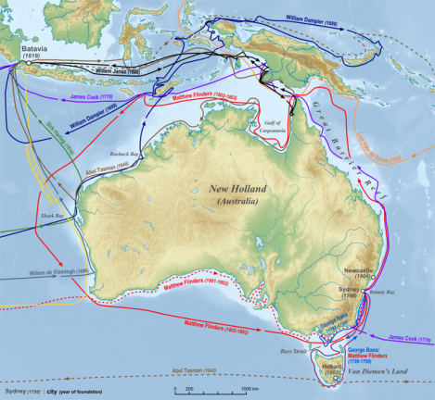
European discovery of the continent
After European discovery of the continent by Dutch explorers in 1606, Australia’s eastern half was claimed by Great Britain in 1770 and initially settled through penal transportation to the colony of New South Wales from 26 January 1788.

Slide 9
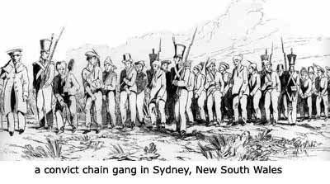
First settlers
Most of the first settlers were convicts sent by the English government. They started the first colony on the „new” continent. It was called Sydney.

Slide 10
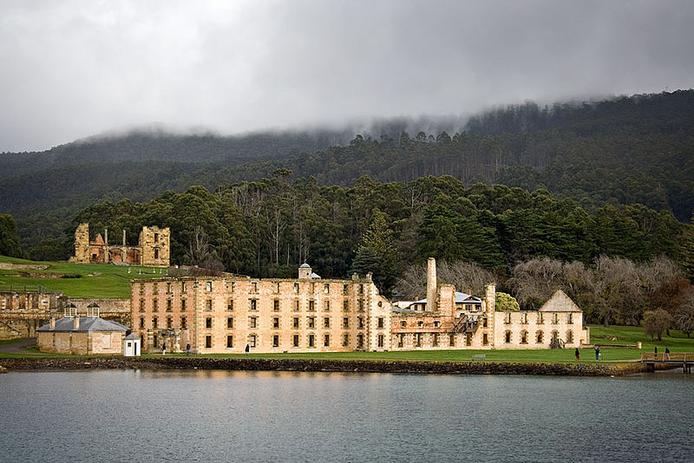
Port Arthur is a small town and former convict settlement on the Tasman Peninsula, in Tasmania, Australia. Port Arthur is one of Australia's most significant heritage areas and an open air museum.

Slide 11
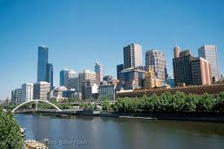
Towns and cities
Most Australians live in the big cities on the southeast and east coast. Only one in seven people live in the country (outside the cities)

Slide 12
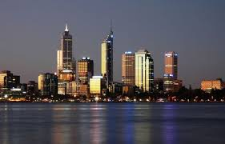
Capital of Australia
Canberra is the capital of Australia and the most prominent city in the Australian Capital Territory (ACT), home to Australia's Parliament. It was designed and built in the early 20th century.

Slide 13
Construction of Canberra
The site of Canberra was selected for the location of the nation's capital in 1908 as a compromise between rivals Sydney and Melbourne, Australia's two largest cities. It is unusual among Australian cities, being an entirely planned city outside of any state, similar to the American Federal District of Columbia. Following an international contest for the city's design, a blueprint by the Chicago architects Walter Burley Griffin and Marion Mahony Griffin was selected and construction commenced in 1913.^{[5}

Slide 14
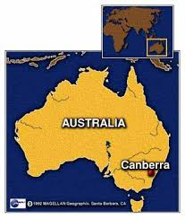
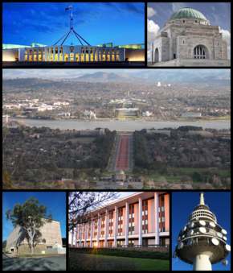
Canberra
The city is located at the northern end of the Australian Capital Territory (ACT), 280 km (170 mi) south-west of Sydney, and 660 km (410 mi) north-east of Melbourne.
With a population of 381,488, it is Australia's largest inland city and the eighth-largest city overall.

Slide 15
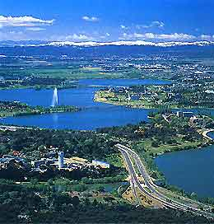
Canberra
In 1963, the Molonglo River was dammed to create a vast artificial lake in the centre of Canberra - Lake Burley Griffin, which was named after the American architect responsible for the overall design of the city (Walter Burley Griffin), and immediately transformed the landscape.

Slide 16
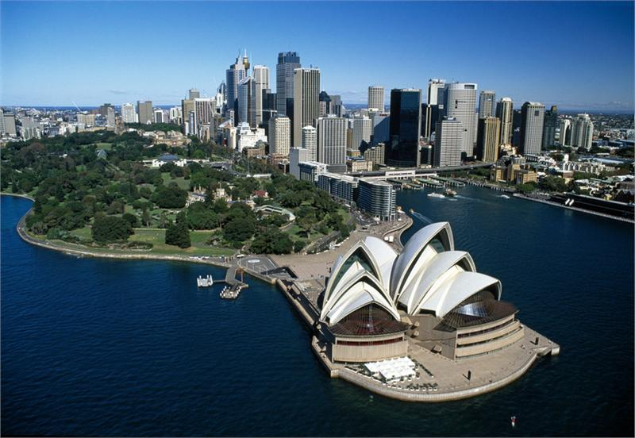
The largest cities
The two largest cities are Sydney (about 4 million people) and Melbourne (about 3 million people). Both of them are Olympic cities.

Slide 17
Sydney
Sydney is the oldest European settlement in Australia, having been founded as a British penal colony on 26 January 1788 (now celebrated as Australia Day, the national public holiday, with major festivities around the city and the Harbour). The settlement, commanded by Governor Arthur Phillip, was named "Sydney" after Thomas Townshend, 1st Viscount Sydney, who was the British Home Secretary at that time.

Slide 18
Port Jackson
Port Jackson, containing Sydney Harbour, is the natural harbour of Sydney, New South Wales, Australia. The harbour is an inlet of the Tasman Sea (part of the South Pacific Ocean). Widely considered to be one of the world's finest harbours^{[citation needed]}, it is the location of the Sydney Opera House and Sydney Harbour Bridge.

Slide 19
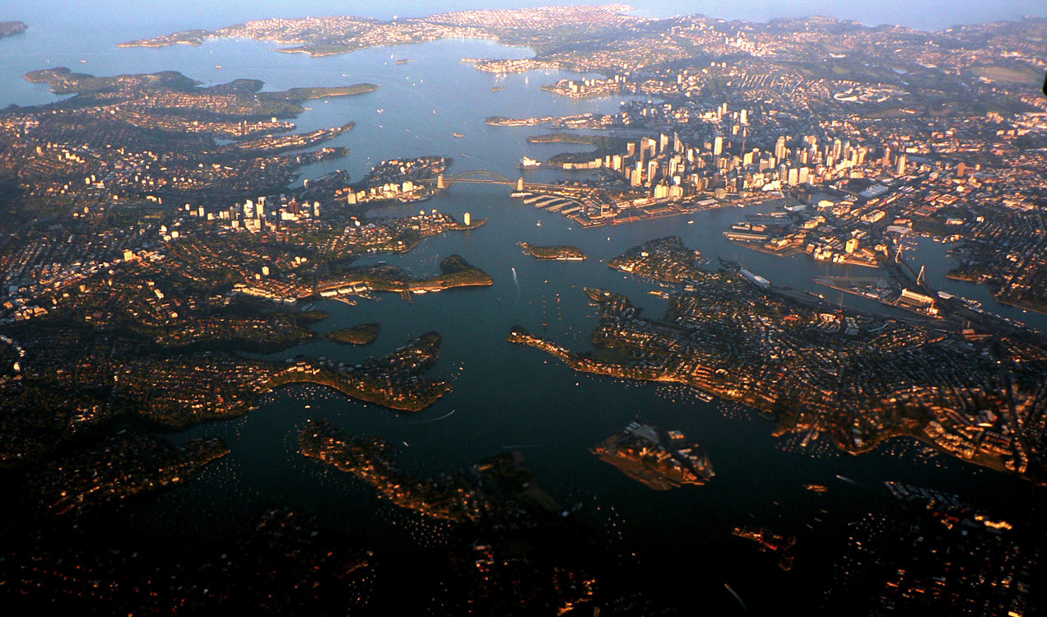
Port Jackson

Slide 20
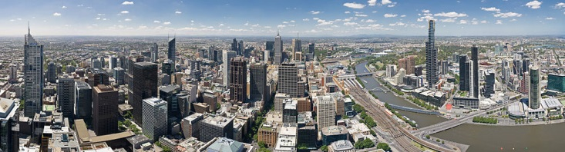
Melbourne

Slide 21
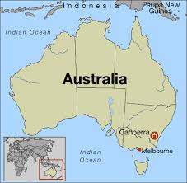
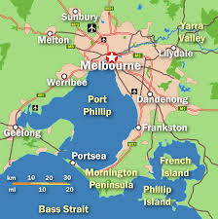
Melbourne

Slide 22
Melbourne
Melbourne (/ˈmɛlbən/)^{[4][5]} is the capital and most populous city in the state of Victoria, and the second most populous city in Australia.
It is located on the large natural bay of Port Phillip, with its City Centre situated at the northernmost point of the bay – near to the estuary of the Yarra River.

Slide 23
Melbourne
Founded on 30 August 1835 (in what was then the Colony of New South Wales), by settlers from Launceston in Van Diemen's Land.
It was declared a city by Queen Victoria in 1847,^{[18]} before becoming the capital city of the newly created Colony of Victoria in 1851.

Slide 24
Melbourne
After the federation of Australia in 1901, Melbourne served as the interim seat of government for the newly created nation of Australia until 1927.^{[20]}
At the time of Australia's federation on 1 January 1901, Melbourne became the seat of government of the federation. The first federal parliament was convened on 9 May 1901 in the Royal Exhibition Building, subsequently moving to the Victorian Parliament House where it was located until 1927, when it was moved to Canberra.

Slide 25
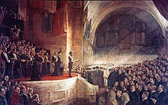
The Big Picture, the opening of the first Parliament of Australia on 9 May 1901, painted by Tom Roberts

Slide 26
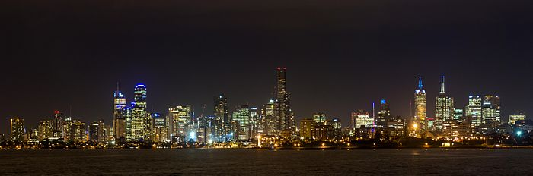
Melbourne skyline at night

